Slide 1
Computação Evolucionária Arcabouço do AG e Comparação ao Random Walk
Alexandre Farias Baía

Slide 2
Agenda
Introdução
Objetivo
Diagramas UML
Algoritmo Genético Vs Caminhada Aleatória (Random Walk)
Conclusão
Agradecimento

Slide 3
Introdução
Este trabalho tem a função de desenvolver um arcabouço para o Algoritmo Genético (AG).
Um algoritmo de Caminhada Aleatória também é desenvolvido para fins de comparação com o desempenho do AG.

Slide 4
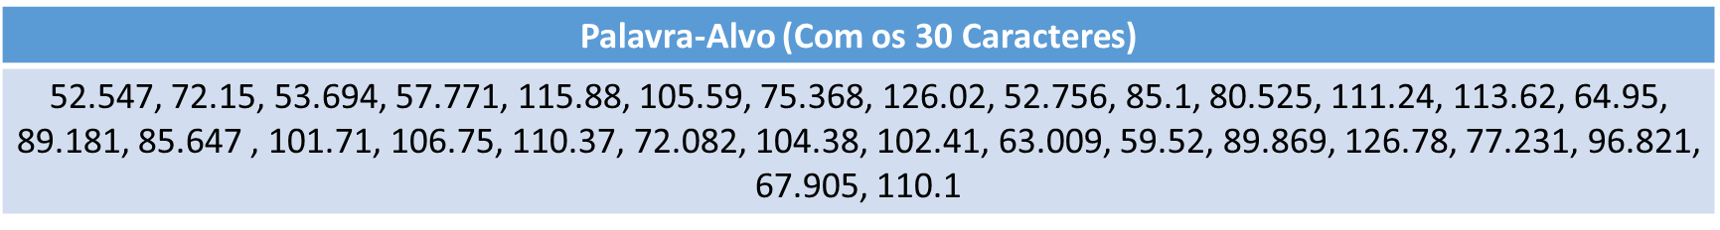
Objetivo
A implementação tem como objetivo fazer com que tanto o AG como o Random Walk sejam capazes de acertar uma palavra-alvo de acordo seus n primeiros caracteres (10, 20 e 30), para populações de 50 a 100 cromossomos, ao longo de 5 execuções.
Gráficos e tabelas são utilizados para a ilustrar os resultados obtidos.

Slide 5
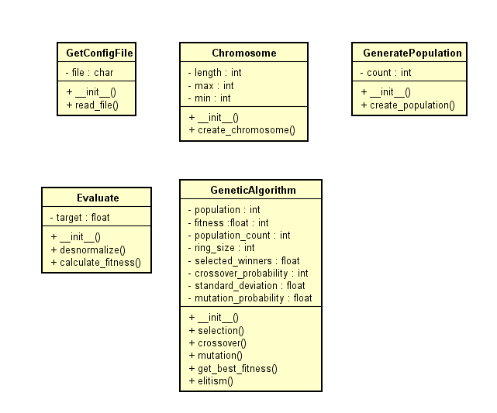
Diagrama UML - AG

Slide 6
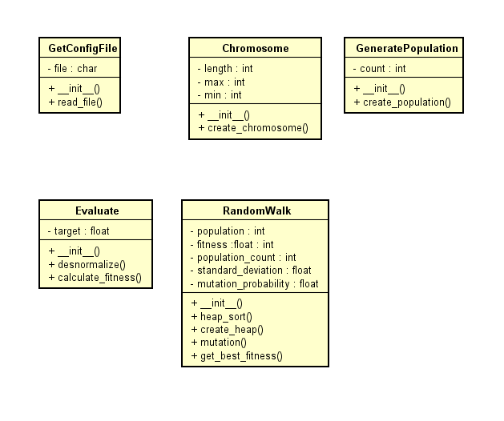
Diagrama UML – Random Walk

Slide 7
Algoritmo Genético Vs Random Walk
Quanto a demonstração dos resultados em gráficos:
Colocar no mesmo gráfico a evolução do RW e AG (Calcular a média e o desvio padrão por geração das R execuções do fitness do melhor indivíduo)
Avaliar o desvio padrão das soluções finais encontras nas R execuções (precisão)
Fazer um gráfico de barra com a média e desvio padrão de número de acertos de valores da palavra alvo
Avaliar a média e desvio padrão do desvio da palavra encontrada da alvo (acurácia)

Slide 8
Algoritmo Genético Vs Random Walk
Parâmetro | 10/50 | 20/50 | 30/50 | 10/100 | 20/100 | 30/100
Tamanho do Ring | 5 | 5 | 5 | 5 | 5 | 5
Probabilidade de Cruzamento | 0.7 | 0.7 | 0.7 | 0.7 | 0.7 | 0.7
Probabilidade de Mutação | 0.03 | 0.03 | 0.03 | 0.03 | 0.03 | 0.03
Desvio-Padrão | 0.01 | 0.01 | 0.01 | 0.01 | 0.01 | 0.01
Número de Gerações | 3000 | 4000 | 6000 | 3000 | 4000 | 6000
Seleção: Torneio
Cruzamento: Aritmético
Mutação: Gaussiana
Troca de População: Geracional
Elitismo: Sim

Slide 9
Algoritmo Genético Vs Random Walk
Soluções Encontradas para 10 caracteres da Palavra Alvo (AG, População 50)
52.547, 72.15, 53.694, 57.771, 115.88, 105.59, 75.368, 126.02, 52.756, 85.1
52.547, 72.15, 53.694, 57.771, 115.88, 105.59, 75.368, 126.02, 52.756, 85.1
52.547, 72.15, 53.694, 57.771, 115.88, 105.59, 75.368, 126.02, 52.756, 85.1
52.547, 72.15, 53.694, 57.771, 115.88, 105.59, 75.368, 126.02, 52.756, 85.1
52.547, 72.15, 53.694, 57.771, 115.88, 105.59, 75.368, 126.02, 52.756, 85.1

Slide 10
Algoritmo Genético Vs Random Walk
Soluções Encontradas para 10 caracteres da Palavra Alvo (Random Walk, População 50)
52.732, 82.238, 52.591, 66.476, 106.637, 105.501, 75.594, 105.05, 52.558, 87.07
57.301, 61.854, 51.889, 57.654, 117.893, 102.462, 79.39, 115.049, 52.776, 88.776
52.486, 69.391, 55.91, 54.542, 97.037, 107.31, 82.451, 109.434, 61.402, 86.172
52.778, 52.274, 60.324, 59.07, 112.418, 97.007, 78.354, 117.761, 52.395, 89.974
58.738, 52.182, 52.322, 52.281, 110.554, 109.5, 76.448, 113.858, 61.638, 89.571

Slide 11
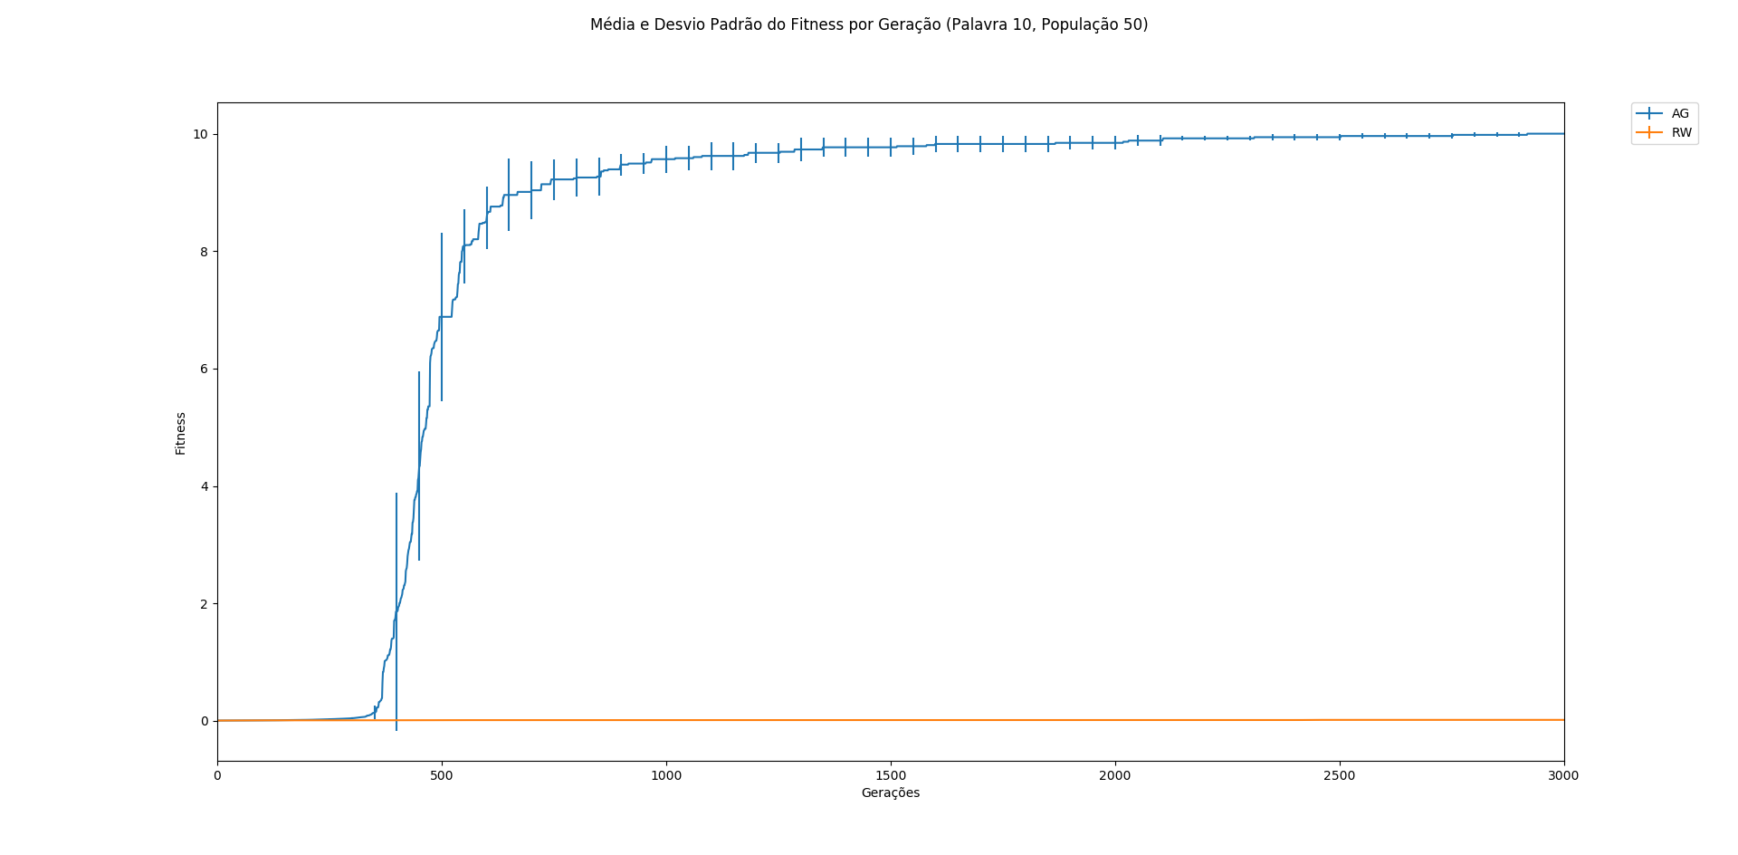
Algoritmo Genético Vs Random Walk

Slide 12
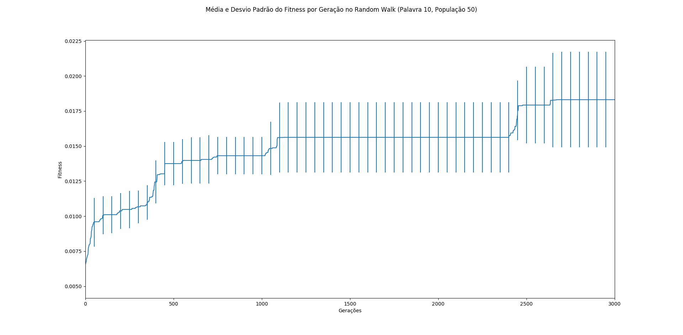
Algoritmo Genético Vs Random Walk

Slide 13
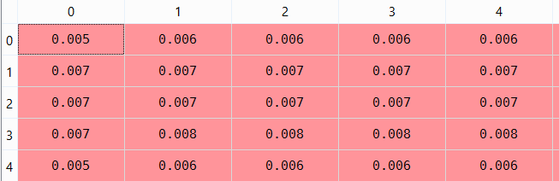
Algoritmo Genético Vs Random Walk
Observa-se um desvio-padrão próximo de zero logo no inicio do AG, porém este valor não é zero, mas sim próximo de zero, sendo assim acaba não aparecendo no gráfico, como mostra a tabela.
Esse comportamento se repete para os outros casos do AG.
Desvio-Padrão das 5 primeiras geração com Palavra 10 e População 50
8.735201856926767556e-04
8.425736660485068190e-04
8.082386781566681597e-04
8.066907344651185960e-04
7.932852442757415802e-04

Slide 14
Algoritmo Genético Vs Random Walk
Soluções Encontradas para 20 caracteres da Palavra-Alvo (AG, População 50)
52.547, 72.15, 53.694, 57.771, 115.88, 105.59, 75.368, 126.02, 52.756, 85.1, 80.525, 111.24, 113.62, 64.95, 89.181, 85.647, 101.71, 106.75, 110.37, 72.082
52.547, 72.15, 53.694, 57.771, 115.88, 105.59, 75.368, 126.02, 52.756, 85.1, 80.525, 111.24, 113.62, 64.95, 89.181, 85.647, 101.71, 106.75, 110.37, 72.082
52.547, 72.15, 53.694, 57.771, 115.88, 105.59, 75.368, 126.02, 52.756, 85.1, 80.525, 111.24, 113.62, 64.95, 89.181, 85.647, 101.71, 106.75, 110.37, 72.082
52.547, 72.15, 53.694, 57.771, 115.88, 105.59, 75.368, 126.02, 52.756, 85.1, 80.525, 111.24, 113.62, 64.95, 89.181, 85.647, 101.71, 106.75, 110.37, 72.082
52.547, 72.15, 53.694, 57.771, 115.88, 105.59, 75.368, 126.02, 52.756, 85.1, 80.525, 111.24, 113.62, 64.95, 89.181, 85.647, 101.71, 106.75, 110.37, 72.082

Slide 15
Algoritmo Genético Vs Random Walk
Soluções Encontradas para 20 caracteres da Palavra-Alvo (Random Walk, População 50)
52.046, 76.91, 52.546, 58.572, 107.802, 102.557, 82.675, 115.783, 56.561, 82.476, 96.082, 122.356, 81.572, 82.836, 104.6, 72.081, 123.255, 124.258, 104.132, 68.263
78.128, 65.933, 53.529, 61.787, 116.977, 102.489, 63.134, 122.552, 57.448, 65.138, 58.092, 114.942, 117.57, 77.719, 102.918, 96.722, 108.535, 105.372, 101.415, 68.574
67.116, 70.266, 63.55, 62.643, 115.689, 77.168, 86.848, 101.192, 70.47, 86.127, 71.462, 107.138, 106.171, 76.984, 74.029, 100.186, 104.49, 103.712, 107.896, 74.955
72.546, 56.898, 75.223, 90.719, 112.351, 105.638, 71.309, 123.529, 61.138, 97.984, 88.765, 124.439, 107.294, 64.923, 100.926, 82.166, 80.944, 95.038, 120.294, 68.466
67.815, 73.984, 50.413, 51.085, 120.244, 103.68, 70.052, 97.825, 53.857, 82.368, 69.25, 104.047, 101.44, 68.077, 79.573, 115.715, 108.679, 107.133, 115.585, 80.434

Slide 16
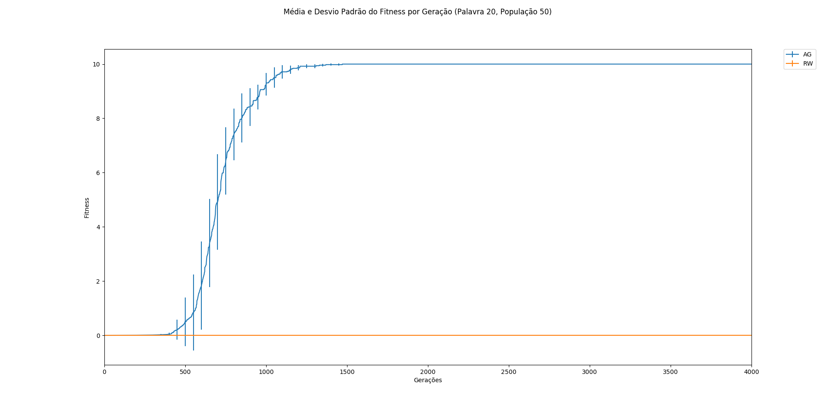
Algoritmo Genético Vs Random Walk

Slide 17
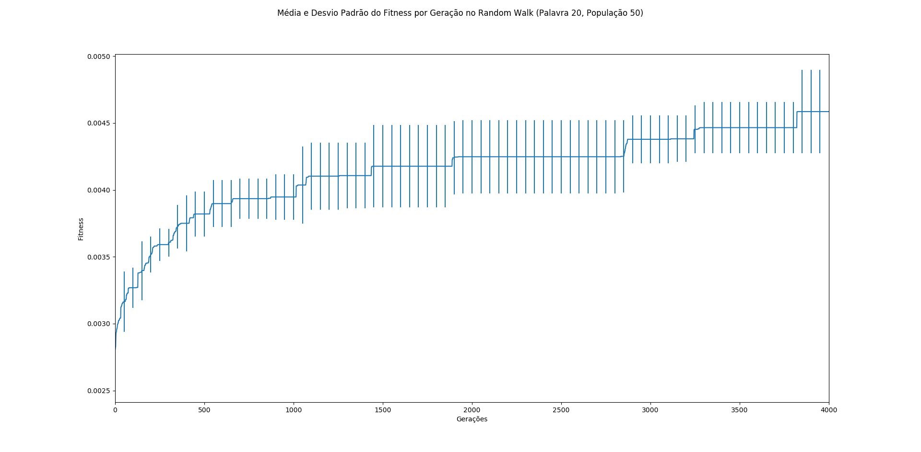
Algoritmo Genético Vs Random Walk

Slide 18
Algoritmo Genético Vs Random Walk
Soluções Encontradas para 30 caracteres da Palavra-Alvo (AG, População 50)
52.547, 72.15, 53.694, 57.771, 115.88, 105.59, 75.368, 126.02, 52.756, 85.1, 80.525, 111.24, 113.62, 64.95, 89.181, 85.647, 101.71, 106.75, 110.37, 72.082, 104.38, 102.41, 63.009, 59.52, 89.869, 126.78, 77.231, 96.821, 67.905, 110.1
52.547, 72.15, 53.694, 57.771, 115.88, 105.59, 75.368, 126.02, 52.756, 85.1, 80.525, 111.24, 113.62, 64.95, 89.181, 85.647, 101.71, 106.75, 110.37, 72.082, 104.38, 102.41, 63.009, 59.52, 89.869, 126.78, 77.231, 96.821, 67.905, 110.1
52.547, 72.15, 53.694, 57.771, 115.88, 105.59, 75.368, 126.02, 52.756, 85.1, 80.525, 111.24, 113.62, 64.95, 89.181, 85.647, 101.71, 106.75, 110.37, 72.082, 104.38, 102.41, 63.009, 59.52, 89.869, 126.78, 77.231, 96.821, 67.905, 110.1
52.547, 72.15, 53.694, 57.771, 115.88, 105.59, 75.368, 126.02, 52.756, 85.1, 80.525, 111.24, 113.62, 64.95, 89.181, 85.647, 101.71, 106.75, 110.37, 72.082, 104.38, 102.41, 63.009, 59.52, 89.869, 126.78, 77.231, 96.821, 67.905, 110.1
52.547, 72.15, 53.694, 57.771, 115.88, 105.59, 75.368, 126.02, 52.756, 85.1, 80.525, 111.24, 113.62, 64.95, 89.181, 85.647, 101.71, 106.75, 110.37, 72.082, 104.38, 102.41, 63.009, 59.52, 89.869, 126.78, 77.231, 96.821, 67.905, 110.1

Slide 19
Algoritmo Genético Vs Random Walk
Soluções Encontradas para 30 caracteres da Palavra-Alvo (Random Walk, População 50)
106.634, 63.878, 54.576, 62.442, 81.316, 105.466, 77.386, 95.453, 57.571, 88.146, 79.65, 117.936, 94.497, 64.972, 105.177, 65.55, 76.649, 99.733, 124.101, 74.866, 106.546, 83.006, 66.95, 57.065, 93.524, 120.854, 83.372, 78.896, 58.095, 74.496
57.357, 80.252, 59.239, 57.118, 77.752, 95.085, 53.859, 116.312, 88.829, 62.946, 84.214, 93.296, 75.999, 68.996, 70.222, 71.735, 93.969, 106.934, 122.18, 78.663, 115.984, 63.973, 72.394, 67.67, 74.813, 112.916, 83.602, 106.978, 94.12, 108.463
57.158, 72.32, 97.516, 55.823, 59.485, 122.269, 67.273, 97.19, 106.106, 84.882, 80.358, 103.732, 125.702, 68.313, 105.005, 82.672, 111.896, 109.501, 96.081, 126.351, 104.29, 114.379, 65.746, 56.133, 88.375, 121.211, 107.387, 92.294, 81.8, 109.884
51.959, 70.19, 70.624, 83.522, 61.779, 108.659, 87.156, 121.424, 90.41, 91.734, 63.514, 90.882, 100.458, 66.006, 93.542, 104.866, 118.85, 101.281, 106.622, 65.657, 97.692, 121.827, 51.826, 73.17, 91.129, 71.66, 81.226, 70.979, 65.827, 112.021
59.977, 53.541, 71.266, 67.213, 80.03, 93.373, 85.794, 112.594, 60.689, 72.091, 95.05, 107.652, 124.238, 65.406, 73.993, 90.968, 79.877, 114.053, 99.002, 50.866, 108.439, 116.294, 115.043, 72.994, 87.748, 114.328, 74.958, 74.314, 79.304, 108.899

Slide 20
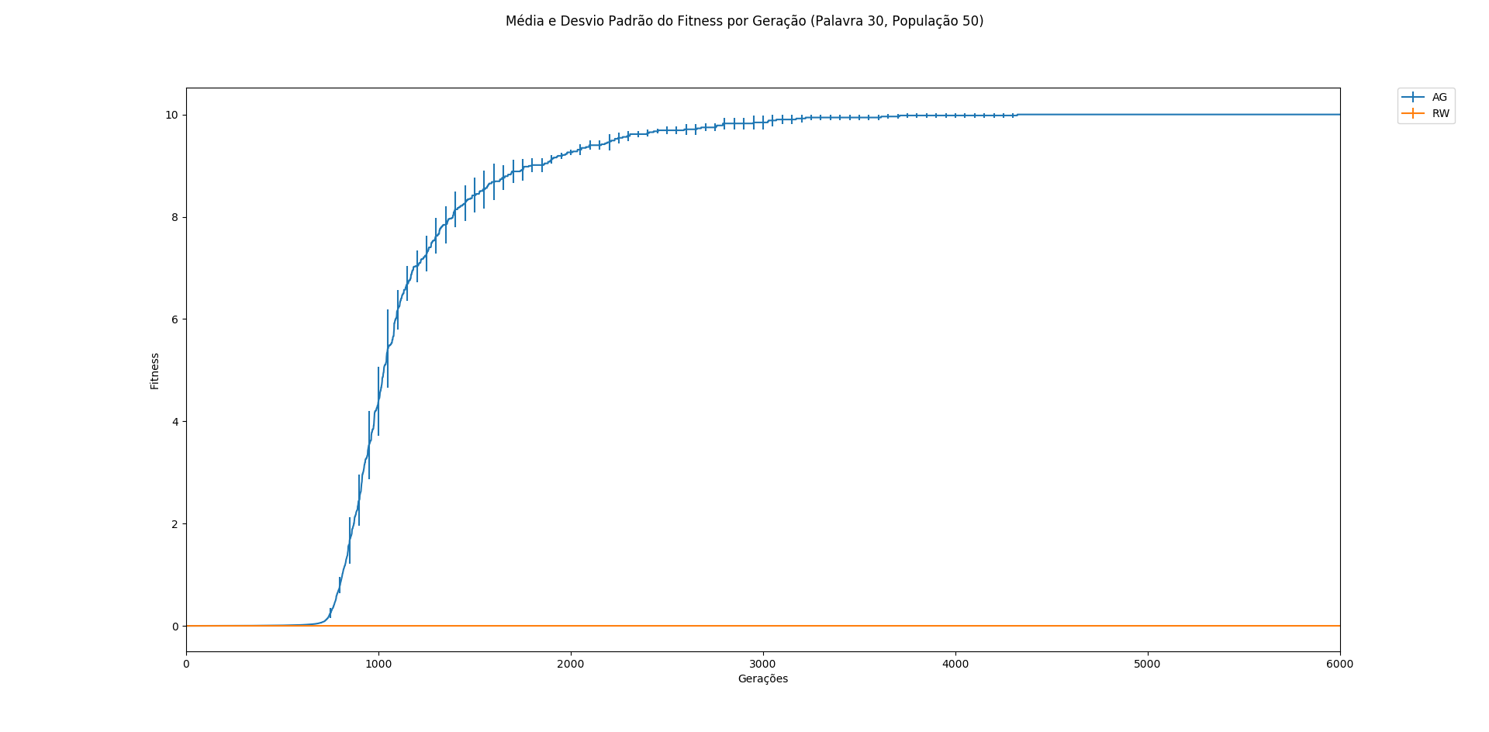
Algoritmo Genético Vs Random Walk

Slide 21
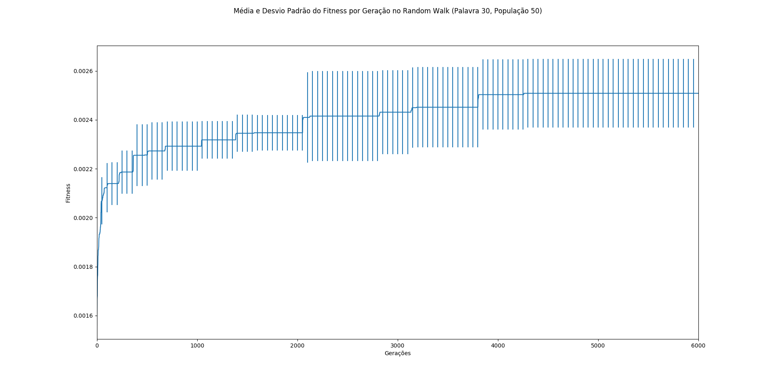
Algoritmo Genético Vs Random Walk

Slide 22
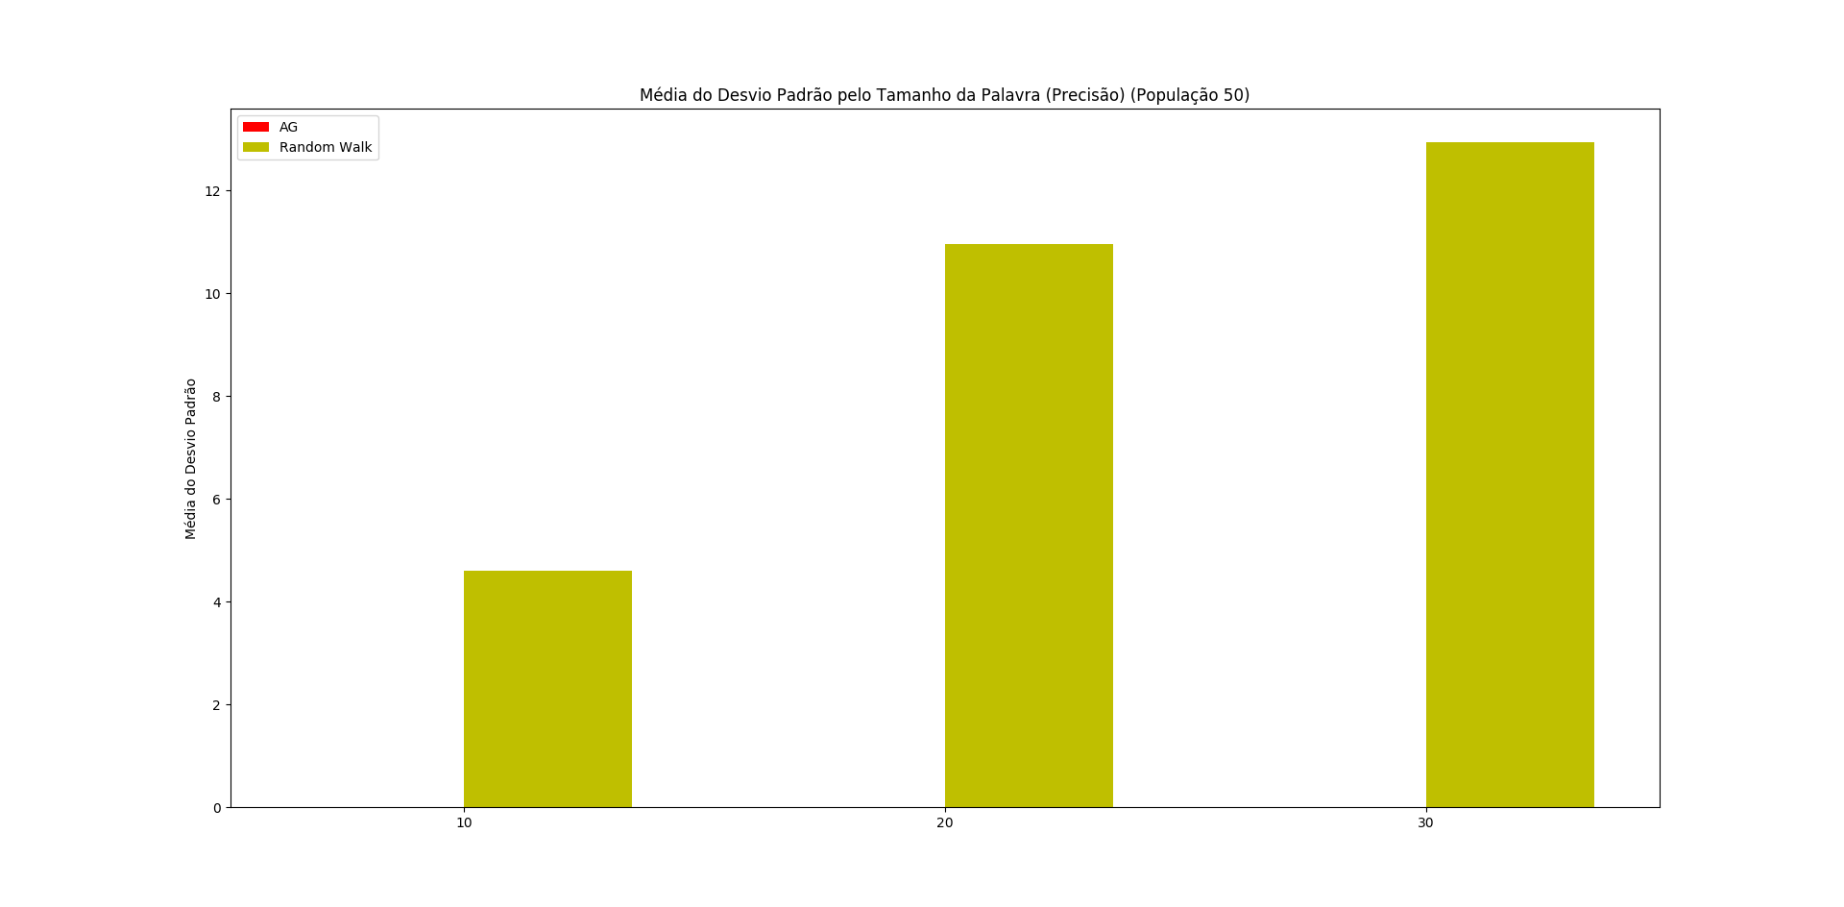
Algoritmo Genético Vs Random Walk

Slide 23
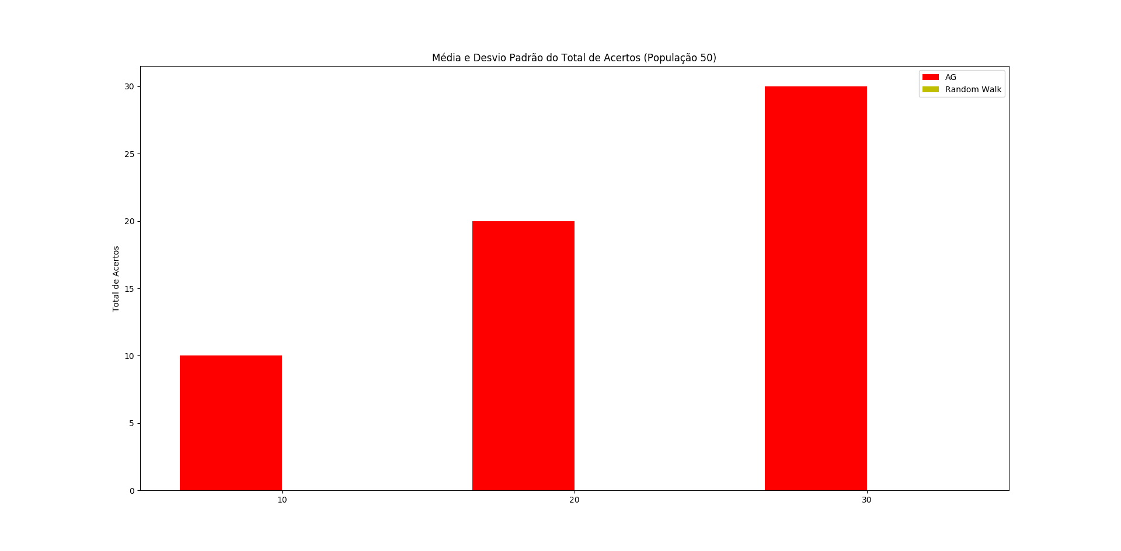
Algoritmo Genético Vs Random Walk

Slide 24
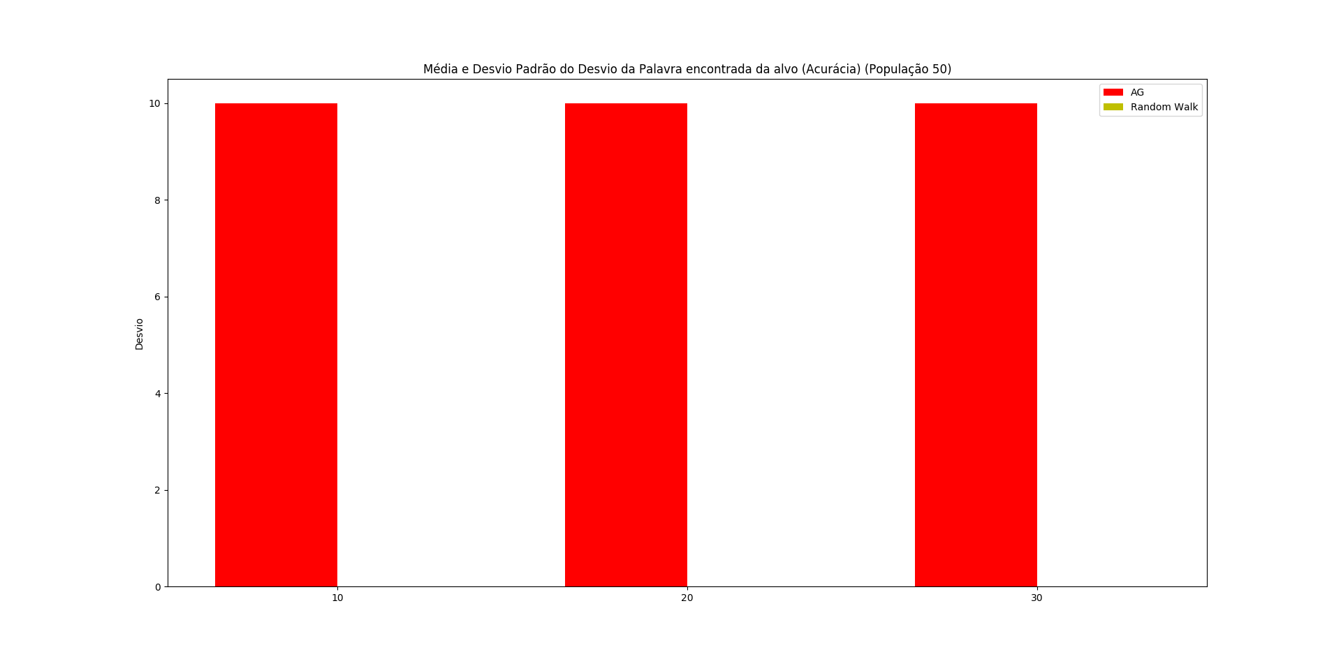
Algoritmo Genético Vs Random Walk

Slide 25
Algoritmo Genético Vs Random Walk
Soluções Encontradas para 10 caracteres da Palavra-Alvo (AG, População 100)
52.547, 72.15, 53.694, 57.771, 115.88, 105.59, 75.368, 126.02, 52.756, 85.1
52.547, 72.15, 53.694, 57.771, 115.88, 105.59, 75.368, 126.02, 52.756, 85.1
52.547, 72.15, 53.694, 57.771, 115.88, 105.59, 75.368, 126.02, 52.756, 85.1
52.547, 72.15, 53.694, 57.771, 115.88, 105.59, 75.368, 126.02, 52.756, 85.1
52.547, 72.15, 53.694, 57.771, 115.88, 105.59, 75.368, 126.02, 52.756, 85.1

Slide 26
Algoritmo Genético Vs Random Walk
Soluções Encontradas para 10 caracteres da Palavra-Alvo (Random Walk, População 100)
53.338, 75.327, 56.934, 57.54, 117.423, 105.382, 71.132, 93.331, 74.82, 84.526
52.912, 75.692, 69.053, 53.842, 98.087, 96.809, 83.986, 118.304, 51.746, 86.122
56.303, 72.131, 55.578, 52.494, 118.347, 108.81, 53.755, 119.686, 52.315, 98.874
50.937, 62.859, 53.093, 58.882, 113.311, 107.515, 75.952, 114.414, 68.207, 110.226
72.029, 81.588, 54.653, 53.272, 118.699, 102.322, 74.358, 108.43, 57.013, 74.891

Slide 27
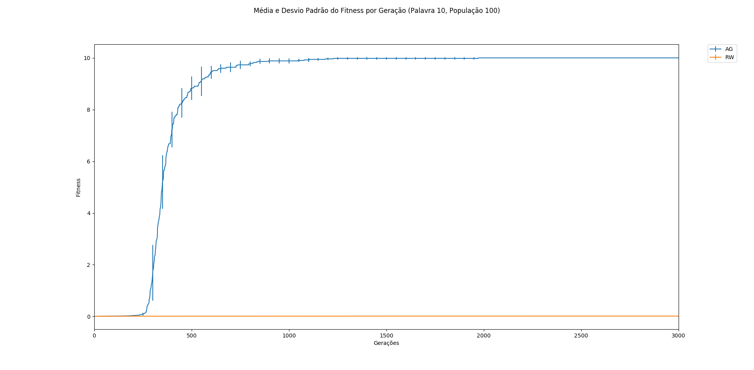
Algoritmo Genético Vs Random Walk

Slide 28
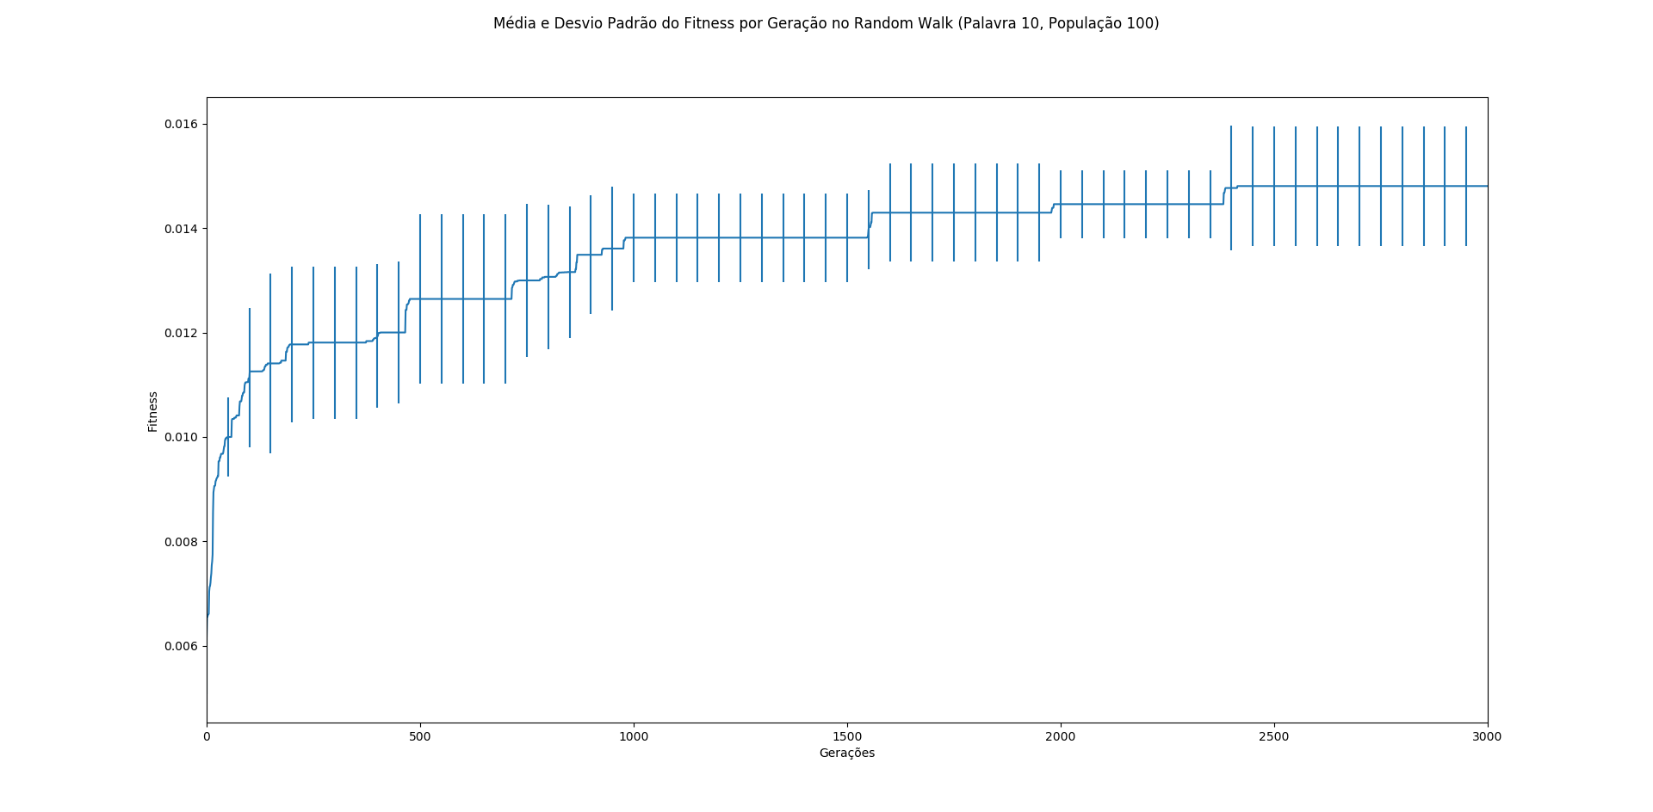
Algoritmo Genético Vs Random Walk

Slide 29
Algoritmo Genético Vs Random Walk
Soluções Encontradas para 20 caracteres da Palavra-Alvo (AG, População 100)
52.547, 72.15, 53.694, 57.771, 115.88, 105.59, 75.368, 126.02, 52.756, 85.1, 80.525, 111.24, 113.62, 64.95, 89.181, 85.647, 101.71, 106.75, 110.37, 72.082
52.547, 72.15, 53.694, 57.771, 115.88, 105.59, 75.368, 126.02, 52.756, 85.1, 80.525, 111.24, 113.62, 64.95, 89.181, 85.647, 101.71, 106.75, 110.37, 72.082
52.547, 72.15, 53.694, 57.771, 115.88, 105.59, 75.368, 126.02, 52.756, 85.1, 80.525, 111.24, 113.62, 64.95, 89.181, 85.647, 101.71, 106.75, 110.37, 72.082
52.547, 72.15, 53.694, 57.771, 115.88, 105.59, 75.368, 126.02, 52.756, 85.1, 80.525, 111.24, 113.62, 64.95, 89.181, 85.647, 101.71, 106.75, 110.37, 72.082
52.547, 72.15, 53.694, 57.771, 115.88, 105.59, 75.368, 126.02, 52.756, 85.1, 80.525, 111.24, 113.62, 64.95, 89.181, 85.647, 101.71, 106.75, 110.37, 72.082

Slide 30
Algoritmo Genético Vs Random Walk
Soluções Encontradas para 20 caracteres da Palavra-Alvo (Random Walk, População 100)
56.664, 54.189, 70.707, 58.27, 90.83, 127.394, 71.664, 129.095, 54.444, 75.413, 57.343, 93.348, 110.926, 93.261, 84.589, 96.684, 106.283, 115.165, 109.602, 71.671
53.099, 59.356, 52.593, 57.827, 120.474, 122.314, 72.607, 116.925, 52.785, 113.321, 95.323, 81.762, 113.23, 61.019, 94.27, 87.411, 120.362, 91.557, 105.126, 64.778
79.891, 66.929, 52.57, 52.851, 109.838, 53.282, 85.39, 107.613, 52.826, 97.639, 83.533, 111.13, 112.574, 52.967, 115.477, 87.951, 107.198, 120.938, 95.245, 76.705
51.445, 59.026, 71.682, 71.593, 115.848, 115.255, 77.071, 116.802, 88.448, 63.765, 95.597, 115.338, 111.858, 51.839,102.722, 51.455, 106.538, 106.798, 105.8, 66.738
75.948, 71.405, 93.179, 59.212, 123.194, 102.255, 54.772, 116.417, 73.303, 87.913, 78.677, 127.019, 104.19, 60.899, 115.84, 85.18, 97.546, 111.782, 98.002, 73.632

Slide 31
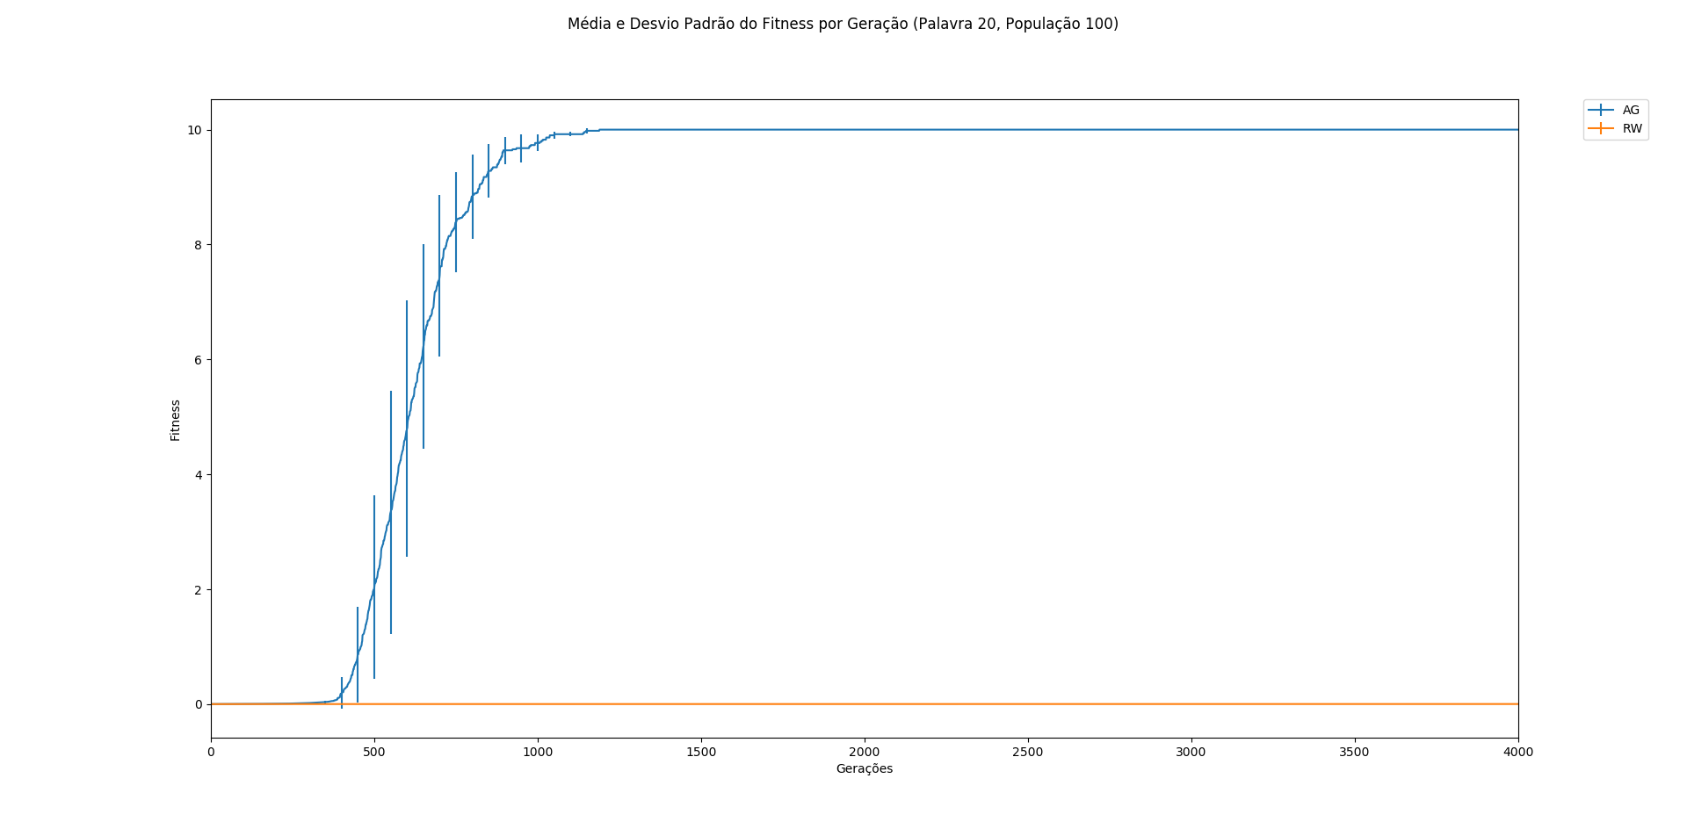
Algoritmo Genético Vs Random Walk

Slide 32
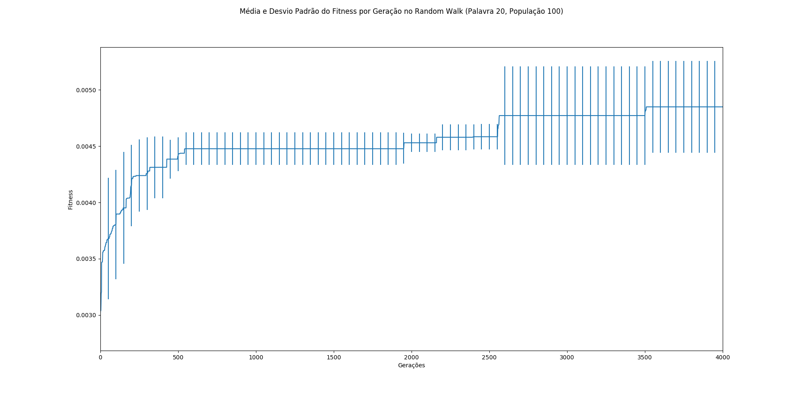
Algoritmo Genético Vs Random Walk

Slide 33
Algoritmo Genético Vs Random Walk
Soluções Encontradas para 30 caracteres da Palavra-Alvo (AG, População 100)
52.547, 72.15, 53.694, 57.771, 115.88, 105.59, 75.368, 126.02, 52.756, 85.1, 80.525, 111.24, 113.62, 64.95, 89.181, 85.647, 101.71, 106.75, 110.37, 72.082, 104.38, 102.41, 63.009, 59.52, 89.869, 126.78, 77.231, 96.821, 67.905, 110.1
52.547, 72.15, 53.694, 57.771, 115.88, 105.59, 75.368, 126.02, 52.756, 85.1, 80.525, 111.24, 113.62, 64.95, 89.181, 85.647, 101.71, 106.75, 110.37, 72.082, 104.38, 102.41, 63.009, 59.52, 89.869, 126.78, 77.231, 96.821, 67.905, 110.1
52.547, 72.15, 53.694, 57.771, 115.88, 105.59, 75.368, 126.02, 52.756, 85.1, 80.525, 111.24, 113.62, 64.95, 89.181, 85.647, 101.71, 106.75, 110.37, 72.082, 104.38, 102.41, 63.009, 59.52, 89.869, 126.78, 77.231, 96.821, 67.905, 110.1
52.547, 72.15, 53.694, 57.771, 115.88, 105.59, 75.368, 126.02, 52.756, 85.1, 80.525, 111.24, 113.62, 64.95, 89.181, 85.647, 101.71, 106.75, 110.37, 72.082, 104.38, 102.41, 63.009, 59.52, 89.869, 126.78, 77.231, 96.821, 67.905, 110.1
52.547, 72.15, 53.694, 57.771, 115.88, 105.59, 75.368, 126.02, 52.756, 85.1, 80.525, 111.24, 113.62, 64.95, 89.181, 85.647, 101.71, 106.75, 110.37, 72.082, 104.38, 102.41, 63.009, 59.52, 89.869, 126.78, 77.231, 96.821, 67.905, 110.1

Slide 34
Algoritmo Genético Vs Random Walk
Soluções Encontradas para 30 caracteres da Palavra-Alvo (Random Walk, População 100)
57.708, 90.096, 92.017, 62.804, 98.15, 118.046, 67.356, 120.123, 56.688, 50.959, 74.289, 103.658, 118.573, 66.177, 100.815, 50.996, 100.764, 107.374, 112.106, 56.781, 98.81, 97.378, 64.704, 52.844, 90.847, 85.176, 97.467, 60.939, 105.083, 103.555
68.126, 53.475, 56.305, 85.574, 126.972, 76.354, 81.894, 122.897, 51.566, 113.227, 101.274, 95.812, 121.234, 79.294, 71.18, 82.855, 72.378, 99.857, 115.566, 70.216, 107.354, 110.774, 79.127, 55.093, 82.633, 127.874, 69.638, 121.618, 61.298, 91.459
52.027, 82.047, 86.514, 77.587, 102.549, 103.601, 97.273, 114.595, 52.115, 98.382, 51.945, 119.609, 92.19, 87.627, 101.094, 96.007, 99.361, 99.25, 109.594, 63.366, 82.184, 112.283, 95.038, 61.15, 93.198, 102.774, 74.739, 97.478, 101.354, 106.802
52.546, 98.211, 56.79, 61.515, 98.929, 75.237, 71.986, 115.706, 74.742, 72.595, 82.832, 102.122, 121.055, 79.201, 94.854, 101.708, 114.058, 100.572, 100.377, 69.339, 86.026, 103.852, 53.237, 87.472, 79.81, 102.342, 111.826, 108.73, 67.913, 96.45
82.906, 97.782, 62.562, 66.871, 72.059, 99.862, 58.822, 126.546, 51.641, 113.533, 75.261, 122.574, 119.234, 63.264, 71.06, 77.862, 100.122, 99.486, 61.417, 72.231, 106.935, 95.552, 54.209, 105.529, 103.79, 97.378, 86.426, 92.39, 74.36, 119.682

Slide 35
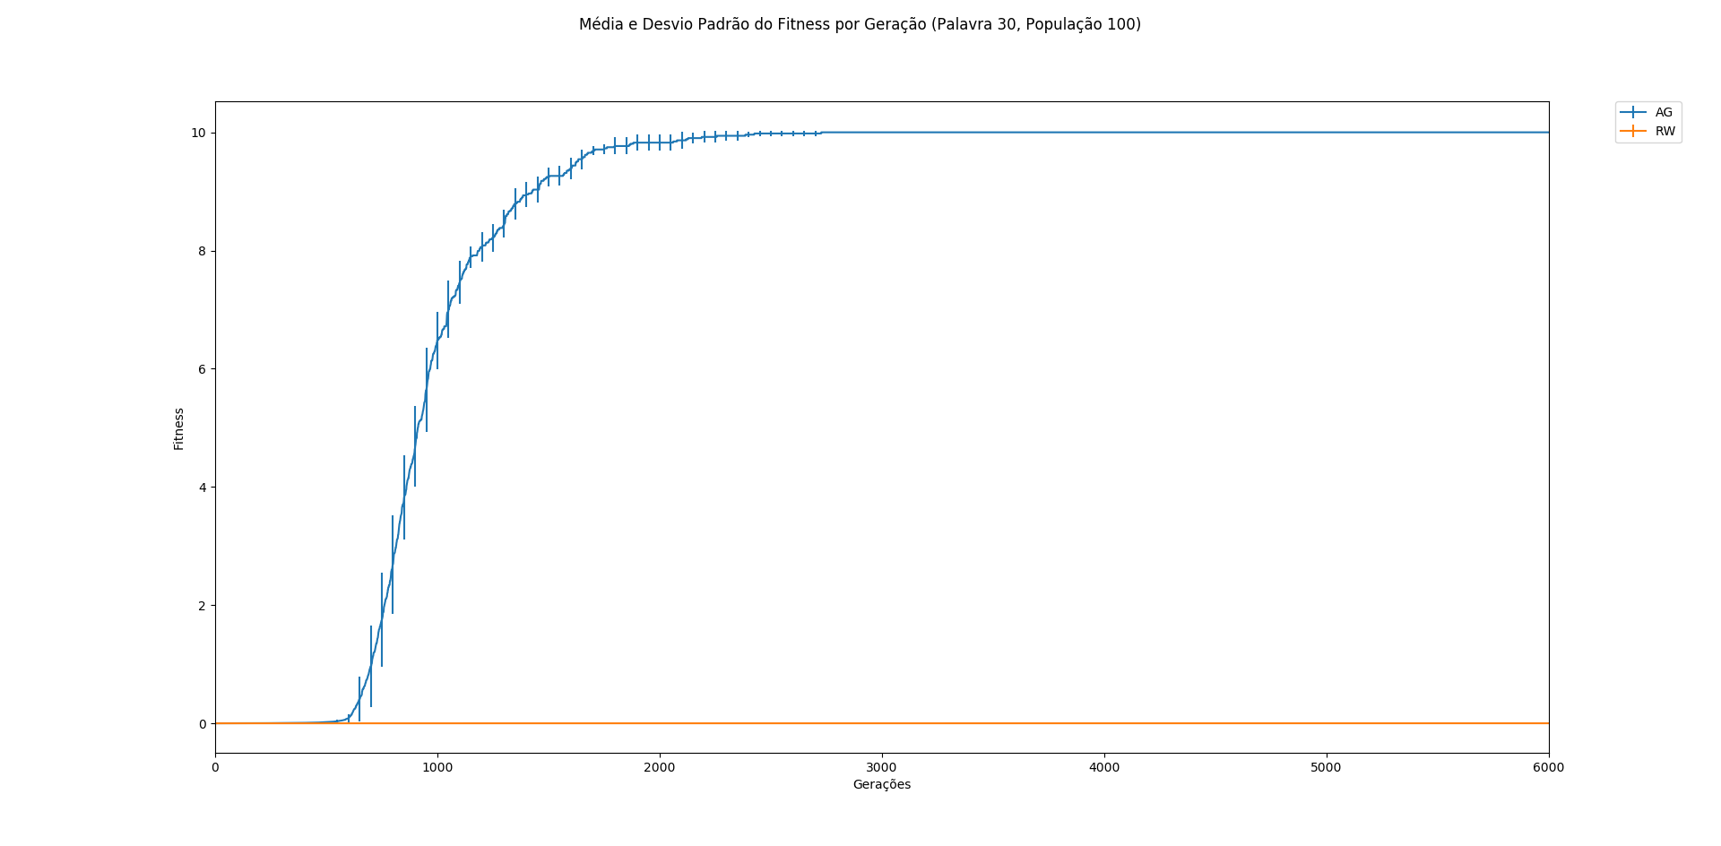
Algoritmo Genético Vs Random Walk

Slide 36
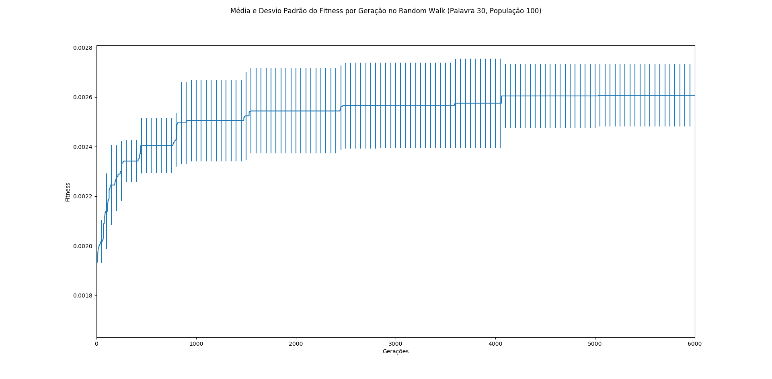
Algoritmo Genético Vs Random Walk

Slide 37

Algoritmo Genético Vs Random Walk

Slide 38

Algoritmo Genético Vs Random Walk

Slide 39

Algoritmo Genético Vs Random Walk

Slide 40
Conclusão
O AG mostrou-se eficiente para encontrar a palavra-alvo, acertando por completo em todos os testes, neste quesito o Random Walk falhou em todos.
Neste trabalho, o AG estava inicialmente com um alto desvio-padrão a cada geração, dificultando sua compreensão. O problema foi resolvido reduzindo a taxa de mutação e desvio-padrão.

Slide 41
Agradecimento
Obrigado pela atenção!

